Slide 1

TRABAJO PRÁCTICO 6: Smart Cities
Inglés II: TUDAI/ TUPAR
Equipo de cátedra: Mgt. Claudia Cañedo
JTP: Mgt. Carolina Barandiaran, Lic. Gabriela A. Llaneza

Slide 2
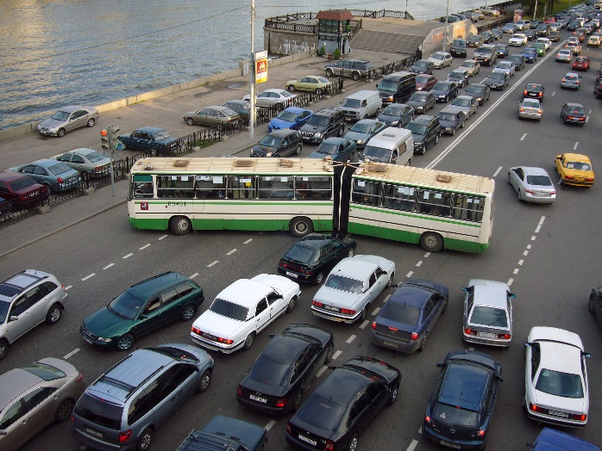
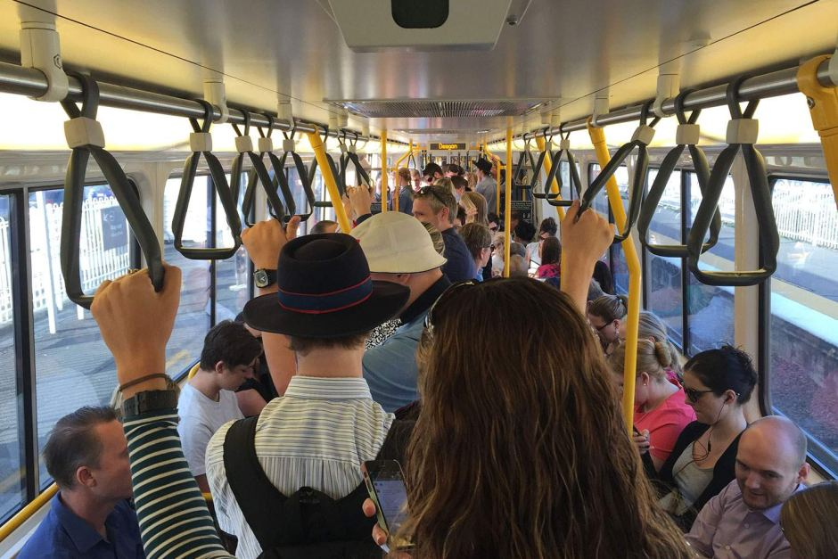
PRE-LECTURA:
1.Observe las siguientes imágenes. Consigne a qué problemas urbanos se refieren y cómo estos afectan la vida de los ciudadanos.
Product A
Product B
Feature 1
Feature 2
Feature 3
Feature 1
Feature 2
Feature 3

Slide 3
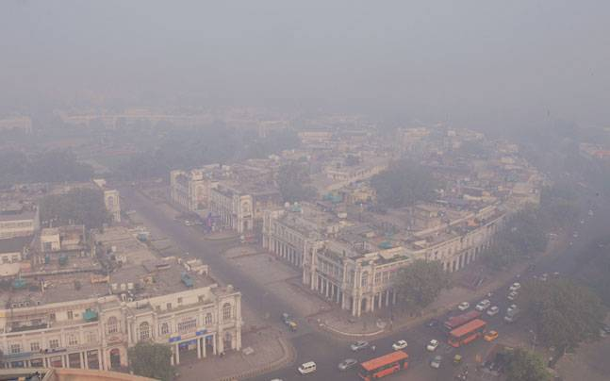
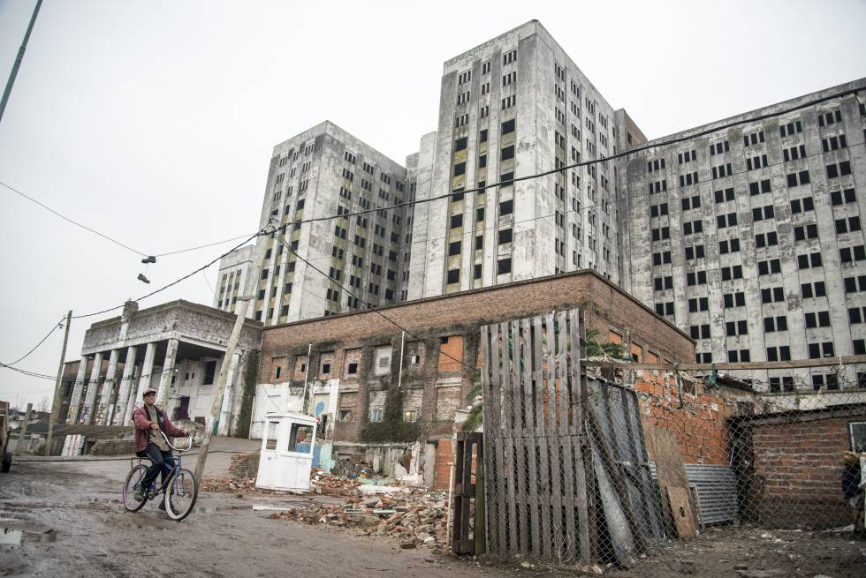


Slide 4

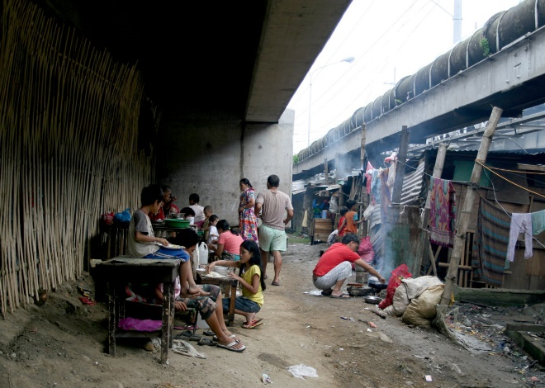
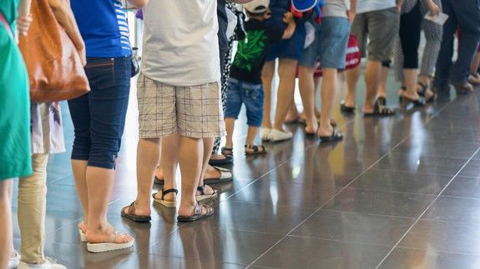

Slide 5
Una de las formas en la que la tecnología pude ayudar a resolver estos problemas en implementar soluciones inteligentes.
Si el concepto es nuevo para vos te invitamos a ver éste video con información complementaria sobre ciudades inteligentes: https://www.youtube.com/watch?v=lKpoi8lf_tI

Slide 6
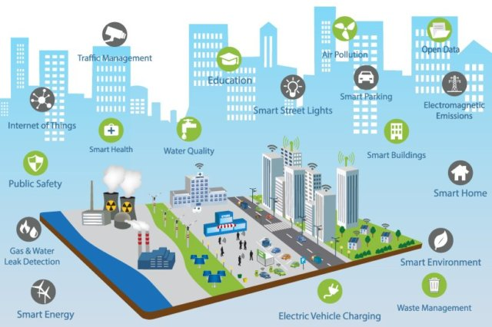
3. Observe la imagen e identifique las características de la ciudad inteligente.

Slide 7
Datos compartidos
Contaminación atmosférica
Control de tránsito
  Estacionamiento inteligente
  Emisiones electromagnéticas
Educación
Internet de las cosas
Alumbrado público inteligente
Sistema de salud
inteligente
Calidad del agua
Edificios inteligentes
Hogar inteligente
Seguridad pública
Detección de fugas de agua y gas
Entorno inteligente
Gestión de residuos
Energía inteligente
Carga de vehículos eléctricos

Slide 8
.
4. Seleccione una de las características de la actividad anterior y explique cómo le gustaría verla aplicada en su ciudad.
Nota: no existe una respuesta única o correcta a esta consigna ya que dependerá su punto de vista y su experiencia con el tema

Slide 9

LECTURA: Comprensión general
5. A continuación trabajaremos con secciones de un texto académico.

Slide 10
Lea el título y proponga dos ideas que espera encontrar explicitadas en el texto
No existe una única ni correcta respuesta para esta consigna. Sin embargo, proponemos 2 ejemplos a continuación:
a. En el texto se desarrollarán temas relacionados a la utilización de internet / internet de las cosas
b. Los autores explicarán las características de las ciudades inteligentes.
6. Realice un barrido de lectura y verifique si sus predicciones aparecen en el texto.
NOTA: Esta respuesta dependerá de las ideas que haya redactado en la consigna anterior.

Slide 11
7. Identifique a que parte del artículo académico corresponden los fragmentos seleccionados. Justifique
Resumen | Introducción
Metodología | Resultados
Discusión | Conclusión
Anexos | Bibliografía

Slide 12
7. Identifique a que parte del artículo académico corresponden los fragmentos seleccionados. Justifique
Resumen | Introducción
Metodología | Resultados
Discusión | Conclusión
Anexos | Bibliografía

Slide 13
8. Complete con los subtítulos correctos en el extracto ‘A’. Tres de los subtítulos no corresponden al texto
Smart Parking | Smart Lighting
Air Quality | Noise Monitoring
Automation and Salubrity of Public Buildings | Virtual Schools
Security Home Policing | Remote Riot Management
Structural Health of Buildings | Waste Management
Traffic Congestion | City Energy Consumption

Slide 14
8. Complete con los subtítulos correctos en el extracto ‘A’. Tres de los subtítulos no corresponden al texto
Smart Parking /g | Smart Lighting /h
Air Quality /c | Noise Monitoring /d
Automation and Salubrity of Public Buildings /i | Virtual Schools
Security Home Policing | Remote Riot Management
Structural Health of Buildings /a | Waste Management /b
Traffic Congestion /e | City Energy Consumption /f

Slide 15
COHESION TEXTUAL:
Los textos presentan características temáticas, léxicas y gramaticales que nos permiten entender el flujo de ideas.
En algunos casos es posible identificar varias palabras que refieren a un tema y crean una red de significados en torno a una idea.
9. Subraye en el extracto ‘A’ las palabras/frases claves que le permitieron identificar los subtítulos en cada caso.
*Teoría a cargo del docente titular. Se incluye como breve revisión y disparador

Slide 16
Structural Health of Buildings: Proper maintenance of the historical buildings ……….actual conditions of each building ……external agents. ……of building structural integrity measurements, buildings, …….structural testing by human operators and will allow targeted and proactive maintenance and restoration actions. …….preserving the city historical heritage.
Waste Management: …..garbage in landfills ……and ecological advantages. ……waste containers,…….collector trucks route, can reduce the cost of waste collection ……waste management ……. the collector truck fleet.

Slide 17
Air Quality: greenhouse gas emissions ……. quality of the air in crowded areas, …….find the healthiest path for outdoor ……air quality and pollution sensors
Noise Monitoring: Sounds can be seen as a form of acoustic pollution ……of noise in the …….noise monitoring …..map of the noise pollution …….the noise of glass ……quiet ……of sound detectors or environmental microphones .
Traffic Congestion: ……in monitoring the traffic congestion in the city. Even though camera-based traffic monitoring systems ……information. Traffic monitoring..

Slide 18
City Energy Consumption: ……….the power consumption …………..of energy required by the different services (public lighting, transportation, traffic lights, control cameras, heating/ cooling of public buildings, ……………..the main energy consumption sources and ……………….. energy efficiency improvement ………. control local power production structures (e.g., photovoltaic panels).
Smart Parking: This service is based on road sensors and ……..that direct motorists along the best path for parking in the city [16]. ……a parking slot means fewer CO emission from the car, lesser traffic congestion, and happier citizens. The smart parking service can be ………system of parking

Slide 19
Smart Lighting: …….of the street lighting ……..the street lamp ……the street lights …….top of the street light controllers.
Automation and Salubrity of Public Buildings……… salubrity of the environment…public buildings (schools, administration offices, and museums) ………the level of comfort …….while reducing the costs for heating/cooling [17].

Slide 20
COEHSION TEXTUAL: Referencia
LEA LAS SIGUIENTES ORACIONES. ¿Considera que son claras o redundantes?
Europe is the continent; in this continent there is a project to develop smart cities.
A primary characteristic of an urban IoT infrastructure is the capability of urban IoT infrastructure of integrating different technologies with the existing communication infrastructures.
In “Internet of Things for Smart Cities” paper, Zanella, Castellani, Vergalista and Zorzi analyzed the solutions currently available for the implementation of urban IoTs.

Slide 21
COEHSION TEXTUAL: Referencia
Europe is the continent where there is a project to develop smart cities.
A primary characteristic of an urban IoT infrastructure is its capability of integrating different technologies with the existing communication infrastructures.
In this paper, we analyzed the solutions currently available for
the implementation of urban IoTs.
*Teoría a cargo del docente titular. Se incluye como breve revisión y disparador

Slide 22
10. Relea el texto y complete el cuadro, consignando a qué refieren las palabras o frases de la primer columna.
this market | The Smart City market
such as | Smart Governance, Smart Mobility, Smart Utilities, Smart Buildings, and Smart Environment
these sectors | Smart Governance, Smart Mobility, Smart Utilities, Smart Buildings, and Smart Environment
this roadblock | the attribution of decision-making power to the different stakeholders
this gap | a clear business model is still lacking
which | adverse global economic situation
such as | smart parking and smart buildings
they | some of the services that might be enabled by an urban IoT paradigm
these services | some of the services that might be enabled by an urban IoT paradigm
we | (autores)

Slide 23
According to Pike Research on Smart Cities,2 the Smart City market is estimated at hundreds of billion dollars by 2020, with an annual spending reaching nearly 16 billions. This market springs from the synergic interconnection of key industry and service sectors, such as Smart Governance, Smart Mobility, Smart Utilities, Smart Buildings, and Smart Environment. These sectors have also been considered in the European Smart Cities project (http://www.smart-cities.eu) to define a ranking criterion that can be used to assess the level of “smartness” of European cities. Nonetheless, the Smart City market has not really taken off yet, for a number of political, technical, and financial barriers [6]. Under the political dimension, the primary obstacle is the attribution of decision-making power to the different stakeholders. A possible way to remove this roadblock is to institutionalize the entire decision and execution process, concentrating the strategic planning and management of the smart city aspects into a single, dedicated department in the city [7]. On the technical side, the most relevant issue consists in the non-interoperability of the heterogeneous technologies currently used in city and urban developments. In this respect, the IoT vision can become the building block to realize a unified urban-scale ICT platform, thus unleashing the potential of the Smart City vision [8], [9].

Slide 24
Finally, concerning the financial dimension, a clear business model is still lacking, although some initiative to fill this gap has been recently undertaken [10]. The situation is worsened by the adverse global economic situation, which has determined a general shrinking of investments on public services. This situation prevents the potentially huge Smart City market from becoming reality. A possible way out of this impasse is to first develop those services that conjugate social utility with very clear return on investment, such as smart parking and smart buildings, and will hence act as catalyzers for the other added-value services [10].

Slide 25
In the rest of this section, we overview some of the services that might be enabled by an urban IoT paradigm and that are of potential interest in the Smart City context, because they can realize the win–win situation of increasing the quality and enhancing the services offered to the citizens while bringing an economical advantage for the city administration in terms of reduction of the operational costs [6]. To better appreciate the level of maturity of the enabling technologies for these services, we report in Table I a synoptic view of the services in terms of suggested type(s) of network to be deployed, expected traffic generated by the service, maximum tolerable delay, device powering, and an estimate of the feasibility of each service with currently available technologies. From the table, it clearly emerges that, in general, the practical realization of most of such services is not hindered by technical issues, but rather by the lack of a widely accepted communication and service architecture that can abstract from the specific features of the single technologies and provide harmonized access to the services

Slide 26
11. En el cuadro anterior, identifique las exóforas, anáforas y catáforas.
this market | The Smart City market ANÁFORA
such as | CATÁFORA
these sectors | ANÁFORA
this roadblock | ANÁFORA
this gap | ANÁFORA
which | ANÁFORA
such as | CATÁFORA
they | ANÁFORA
these services | ANÁFORA
we | EXÓFORA

Slide 27
12. En el extracto ‘B’, algunas de las palabras o frases que facilitan la interpretación creando cohesión no están claras. Lea atentamente y seleccione la opción que a su parecer facilita la comprensión del texto.
THE Internet of Things (IoT) is a recent communication paradigm that envisions a near future, in which the objects of everyday life will be equipped with microcontrollers, transceivers for digital communication, and suitable protocol stacks that will make them able to communicate with one another and with the users, becoming an integral part of the Internet [1]. The IoT concept, hence, aims at making the Internet even more immersive and pervasive. Furthermore, by enabling easy access and interaction with a wide variety of devices; such as home appliances, surveillance cameras, monitoring sensors, actuators, displays, vehicles, and so on; the IoT will foster the development of a number of applications that make use of the potentially enormous amount and variety of data generated by such objects to provide new services to citizens, companies, and public administrations. This paradigm indeed finds application in many different domains, such as home automation, industrial automation, medical aids, mobile healthcare, elderly assistance, intelligent energy management and smart grids, automotive, traffic management, and many others [2].

Slide 28
However, such a heterogeneous field of application makes the identification of solutions capable of satisfying the requirements of all possible application scenarios a formidable challenge. This difficulty has led to the proliferation of different and, sometimes, incompatible proposals for the practical realization of IoT systems.

Slide 29
13. En el extracto ‘B’ faltan algunas palabras o frases. Luego de su lectura, UBÍQUELAS en el texto (identifique la frase extra)
which | (h) | we | (f)
it | (a) | this objective | (b)
their city | (c) | those | (d)
the former | () | its | (i)
their | (g) | this paper | (e)

Slide 30
In this complex scenario, the application of the IoT paradigm to an urban context is of particular interest, as ………………... (a) responds to the strong push of many national governments to adopt ICT solutions in the management of public affairs, thus realizing the so-called Smart City concept [4]. Although there is not yet a formal and widely accepted definition of “Smart City,” the final aim is to make a better use of the public resources, increasing the quality of the services offered to the citizens, while reducing the operational costs of the public administrations. ………………………..(b) can be pursued by the deployment of an urban IoT, i.e., a communication infrastructure that provides unified, simple, and economical access to a plethora of public services, thus unleashing potential synergies and increasing transparency to the citizens.

Slide 31
An urban IoT, indeed, may bring a number of benefits in the management and optimization of traditional public services, such as transport and parking, lighting, surveillance and maintenance of public areas, preservation of cultural heritage, garbage collection, salubrity of hospitals, and school. Furthermore, the availability of different types of data ,collected by a pervasive urban IoT, may also be exploited to increase the transparency and promote the actions of the local government toward the citizens, enhance the awareness of people about the status of …………….(c), stimulate the active participation of the citizens in the management of public administration, and also stimulate the creation of new services upon ………………(d) provided by the IoT [5]. Therefore, the application of the IoT paradigm to the Smart City is particularly attractive to local and regional administrations that may become the early adopters of such technologies, thus acting as catalyzers for the adoption of the IoT paradigm on a wider scale.

Slide 32
The objective of ……………….(e) is to discuss a general reference framework for the design of an urban IoT. We describe the specific characteristics of an urban IoT, and the services that may drive the adoption of urban IoT by local governments. ………………….(f) then overview the web-based approach for the design of IoT services, and the related protocols and technologies, discussing ……………(g) suitability for the Smart City environment. Finally, we substantiate the discussion by reporting our experience in the “Padova Smart City” project, ………………(h) is a proof-of-concept deployment of an IoT island in the city of Padova (Italy) and interconnected with the data network of the city municipality. In this regard, we describe the technical solutions adopted for the realization of the IoT island and report some of the measurements that have been collected by the system in ……………(i) first operational days.

Slide 33
In this complex scenario, the application of the IoT paradigm to an urban context is of particular interest, as it responds to the strong push of many national governments to adopt ICT solutions in the management of public affairs, thus realizing the so-called Smart City concept [4]. Although there is not yet a formal and widely accepted definition of “Smart City,” the final aim is to make a better use of the public resources, increasing the quality of the services offered to the citizens, while reducing the operational costs of the public administrations. This objective can be pursued by the deployment of an urban IoT, i.e., a communication infrastructure that provides unified, simple, and economical access to a plethora of public services, thus unleashing potential synergies and increasing transparency to the citizens.

Slide 34
An urban IoT, indeed, may bring a number of benefits in the management and optimization of traditional public services, such as transport and parking, lighting, surveillance and maintenance of public areas, preservation of cultural heritage, garbage collection, salubrity of hospitals, and school. Furthermore, the availability of different types of data ,collected by a pervasive urban IoT, may also be exploited to increase the transparency and promote the actions of the local government toward the citizens, enhance the awareness of people about the status of their city, stimulate the active participation of the citizens in the management of public administration, and also stimulate the creation of new services upon those provided by the IoT [5]. Therefore, the application of the IoT paradigm to the Smart City is particularly attractive to local and regional administrations that may become the early adopters of such technologies, thus acting as catalyzers for the adoption of the IoT paradigm on a wider scale.

Slide 35
The objective of this paper is to discuss a general reference framework for the design of an urban IoT. We describe the specific characteristics of an urban IoT, and the services that may drive the adoption of urban IoT by local governments. We then overview the web-based approach for the design of IoT services, and the related protocols and technologies, discussing their suitability for the Smart City environment. Finally, we substantiate the discussion by reporting our experience in the “Padova Smart City” project, which is a proof-of-concept deployment of an IoT island in the city of Padova (Italy) and interconnected with the data network of the city municipality. In this regard, we describe the technical solutions adopted for the realization of the IoT island and report some of the measurements that have been collected by the system in its first operational days.

Slide 36
Comprensión detallada.
14. Relea el material y elija la opción correcta en cada caso

Slide 37
  a. ¿Qué es Internet de las cosas?
    Un paradigma de las comunicaciones que propone la interconexión de dispositivos de la vida diaria
    Un sistema de comunicación que facilita la independencia de los dispositivos
    La aplicación de aplicaciones conectividad a redes sociales en electrodomésticos
    Una plataforma de Android para la experimentación libre
  b. ¿Cuáles son los posible beneficios para usuarios?
    Las personas podrían acceder a su información en la nube
    Las ciudades dejarían de requerir trámites personales
    Las escuelas contarían con conectividad gratuita
    La información generada permitirá múltiples aplicaciones y servicios para empresas y la administración pública.

Slide 38
  c. ¿Cuáles son los desafíos en la implementación del nuevo paradigma?
    Pocos desarrolladores están interesados en el desafío
    Falta tecnología accesible para experimentar
    Falta de estandarización de prácticas de desarrollo y modelo de negocio para atraer inversiones.
    Los inversores no tienen interés en una tecnología experimental
  d. ¿ Cuál es el objetivo de las ciudades inteligentes?
    La vigilancia de los ciudadanos y reducción de los índices de criminalidad
    Mejorar el uso y la calidad de los recursos públicos.
    Propiciar la reducción de personal estatal
    Llevar servicios a los suburbios de las ciudades.

Slide 39
  e. ¿ Por qué no se ha implementado el proyecto europeo para crear ciudades inteligentes?
  i. Existen obstáculos políticos, técnicos y económicos.
  ii. Las ciudades prefieren métodos tradicionales de gestión.
  iii. Existen pocas ciudades con conectividad ilimitada.
  iv. Los ciudadanos desconfían de tecnología que limite su privacidad.
  f. ¿Cómo puede superarse la barrera tecnológica para la creación de ciudades inteligentes?
    Se pueden alojar los datos en servidores gratuitos.
    Con la distribución de dispositivos móbiles.
    Con la creación de una plataforma urbana IoT para las tecnologías.
    Se puede pedir a los ciudadanos que aporten horas de trabajo en testeo de las aplicaciones.

Slide 40
  g. ¿Cómo ha afectado la crisis global el desarrollo de ciudades inteligentes?
    Ha habido una reducción en la inversión pública.
    Ha subido el costo del petróleo
    Los ciudadanos se oponen a este tipo de inversiones
    Las multinacionales proponen financiar estos proyectos.
  h. ¿Cuál seria el beneficio político de la creación de ciudades inteligentes?
    Los ciudadanos podrían acceder a información sobre las políticas e inversiones públicas y mejorar la imagen de los funcionarios.
    Los ciudadanos podrían identificar a los funcionarios corruptos
    El intercambio de información facilitaría desacreditar a los ciudadanos
    Las elecciones locales podrían realizarse desde dispositivos personales.

Slide 41
  ¿Qué es Internet de las cosas?
    Un paradigma de las comunicaciones que propone la interconexión de dispositivos de la vida diaria
  ¿Cuáles son los posible beneficios para usuarios?
    iv. La información generada permitirá múltiples aplicaciones y servicios para empresas y la administración pública.
  ¿Cuáles son los desafíos en la implementación del nuevo paradigma?
    iii. Falta de estandarización de prácticas de desarrollo y modelo de negocio para atraer inversiones.
  ¿ Cuál es el objetivo de las ciudades inteligentes?
    ii. Mejorar el uso y la calidad de los recursos públicos.

Slide 42
  e) ¿ Por qué no se ha implementado el proyecto europeo para crear ciudades inteligentes?
    Existen obstáculos políticos, técnicos y económicos.
  f) ¿Cómo puede superarse la barrera tecnológica para la creación de ciudades inteligentes?
    iii. Con la creación de una plataforma urbana IoT para las tecnologías.
  g) ¿Cómo ha afectado la crisis global el desarrollo de ciudades inteligentes?
    Ha habido una reducción en la inversión pública.
  h) ¿Cuál sería el beneficio político de la creación de ciudades inteligentes?
    i. Los ciudadanos podrían acceder a información sobre las políticas e inversiones publicas y mejorar la imagen de los funcionarios.

Slide 43
15. Complete el siguiente cuadro con problemas de las ciudades y soluciones posibles aplicando internet de las cosas
Salud estructural de edificios
Gestión de Residuos
Calidad de aire
Contaminación acústica
Sensores dentro y fuera para medir vibración, deformación, temperatura, humedad y polución.
Contenedores que detecten nivel de carga de residuos y software que procese dicha información para optimizar el uso de la flota de camiones de recolección.
Sensores para el monitoreo de áreas con gran afluencia de gente y libre acceso a sus datos.
Servicio de monitoreo de ruidos y desarrollo de un mapa espacio-temporal de la contaminación acústica

Slide 44
Tráfico
Consumo de energía
Estacionamiento
Alumbrado
Sistema de monitoreo con cámaras, GPS en vehículos y comunicación extendida de baja potencia
Dispositivos de monitoreo de consumo de energía
Sensores de ruta, pantallas inteligentes y tecnología de comunicación de corto alcance.
Lámparas con intensidad diferente dependiendo del momento del día, de las condiciones climáticas y de la presencia de personas. Sistema automático de detección.

Slide 45
Automatización y salubridad de los edificios públicos
Sensores y actuadores para el control de la luz, la temperatura y la humedad.

Slide 46
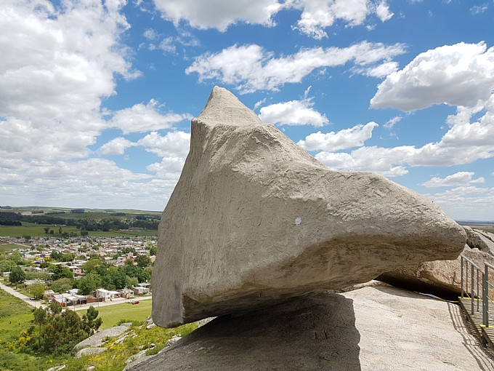
POST-LECTURA
16. Relea los problemas urbanos de Tandil/ su ciudad de origen. Redacte un párrafo explicando su opinión sobre la factibilidad de la solución propuesta en el texto para el caso especifico de Tandil/su ciudad de origen.
NOTA: Esta respuesta dependerá de Ud. pero no olvide incluir una frase introductoria. Por ejemplo:
“En mi opinión, en Tandil sería factible dar solución al problema de ... si se aplicara … ”

Slide 47

17. Redacte un resumen del material sobre internet de las cosas para ciudades inteligentes. (Material de consulta en la página web de la cátedra: ‘El resumen’)

Slide 48
El siguiente texto es un resumen modelo del material sobre internet de las cosas para ciudades inteligentes.
En este texto el autor/los autores hace/n referencia a aquellos objetos de uso cotidiano que a futuro se transformarán en dispositivos inteligentes. Tales dispositivos no sólo se comunicarán entre ellos y permitirán la comunicación con sus usuarios, sino que también almacenarán información útil con el fin de mejorar el servicio de la administración pública y para los ciudadanos. Sin embargo, el autor/los autores sostiene/n que el uso de aplicaciones para la solución de problemas es un desafío. Por un lado, advierten que existen dificultades técnicas en relación al desarrollo de sistemas y de redes del internet de las cosas. Por el otro, no cuentan con modelos comerciales que atraigan inversionistas que hagan posible este cambio. Además, en este texto se considera importante el objetivo del desarrollo de una ciudad inteligente, porque esto implicaría beneficios tales como: acceso a servicios públicos y un uso transparente de los mismos, disponibilidad de datos tanto para la administración pública como para los ciudadanos, entre otros. Por último, el autor/los autores mencionan cuál es el objetivo de artículo de investigación y enumeran sus partes, es decir, qué organización se le ha dado en términos de estructura.

Slide 49
Fin de la presentación

